Slide 1
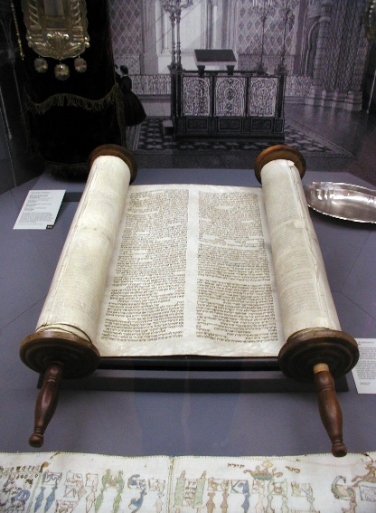
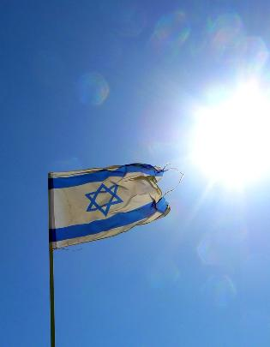

The Ideology of Zionism
From Religious Community to Nation State

Slide 2
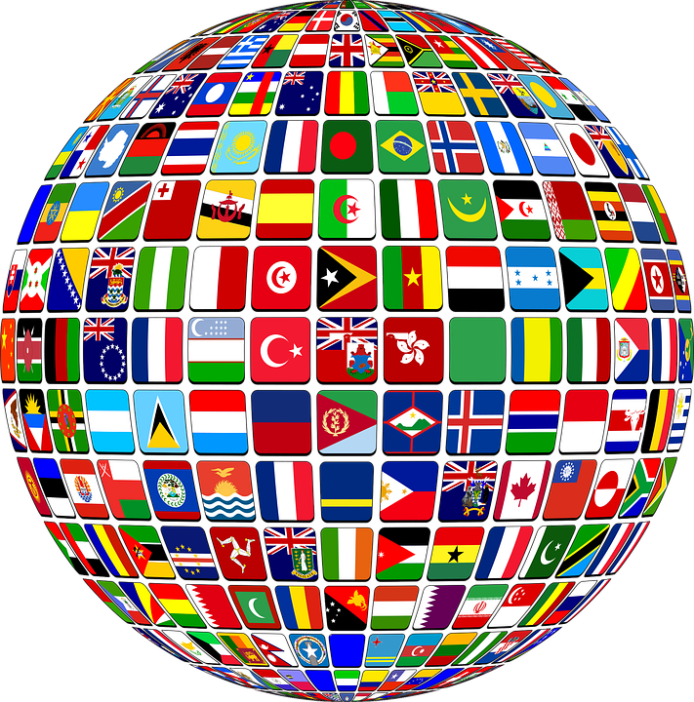
Roots
1880’ Russian Pogroms
Responses? Migrate to USA, or:
Transform a Transnational Jewish Religious identity, Torah centred - into a mostly secular Nation State
But Majority of Jews oppose – Messiah first before rereturn!
A European Nationalist Movement goes Southeast to
Establish Political/Economic control over Palestine

Slide 3
Becoming The ‘New (mostly secular) Jew’
Pioneering, Heroic, Agricultural, Muscular Warrior- cw with ‘Weak’ Jew.
Separate Development – by creating ‘Facts on the Ground’:
Build Settlements, Kibbutz, Self-Defence units etc
Creating Facts = Zionism's core tactic? ‘
Many Leaders from Russian Empire - acquainted with Political Violence/ Imported into Palestine (70% of 1960 Knesset Russian born)
Projection: Pogroms- ‘Arab Threat’

Slide 4
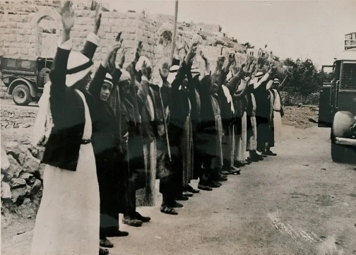
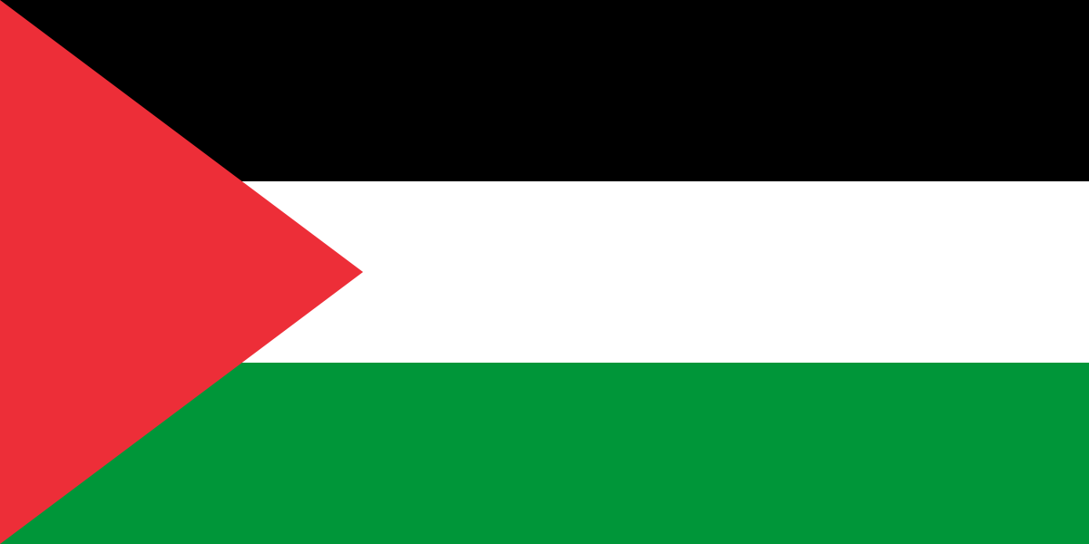
But …. The Palestinians?
Zionist Public Presentations? Self Serving? Bring prosperity. Gradualism.
Privately: All about dominance, achieving majority status.
Jabotinsky: Revisionist (Wants all of Mandated Palestine). ‘Iron Wall’
Same goal, differing strategies… goals once guarded, would later become more and more explicit. Is this the Long-Term repeating trend of Zionism?
Each generation’s ‘Lunatic fringe’s’ keep arriving at the centre.
The lens of ‘Rights the function of tragedies?’

Slide 5
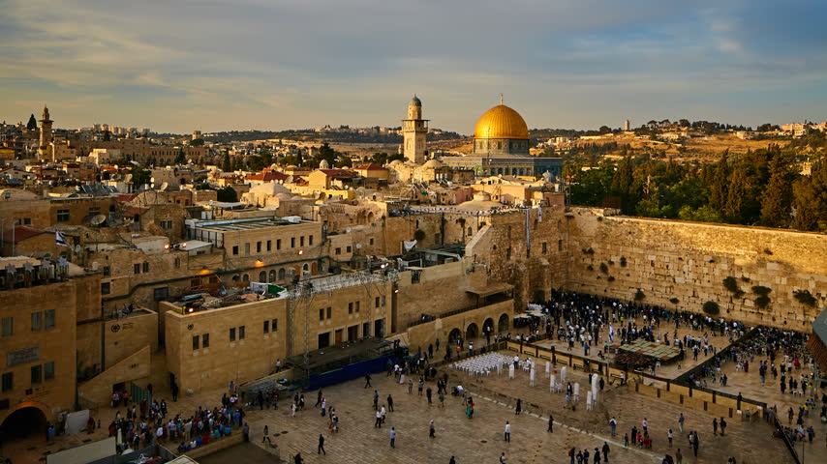
2: The Shift Right
1967 Occupation
The Joshua Blueprint
The Settlers
Gush Emunim,
Nachala
There is no God, but God gave us the land
The Joshua Blueprint
Next Year in Jerusalem
Does the Israeli Army have a State?
Addicted to Violence?

Slide 6

1967
Miraculous? Divine Intervention? Christian Zionism ramps up in USA
In Israel, Religious Dynamics emerge.
Movement from a ‘Secular state for the Jews’ to a specifically Jewish State with a role in a divine redemptive plan.
But see Prophetic Joshua Liebowicz Critique – His call for withdrawal.
Fringe Religious Nationalism begins a march to Centre Stage.
In 1977. Begin’s Likud Party elected. A ‘Sea Change’ Jabotinsky in power.
Its Vanguard was and is the Settler Movement. Which fuses ‘Religious’ with ‘Security’ concerns.

Slide 7
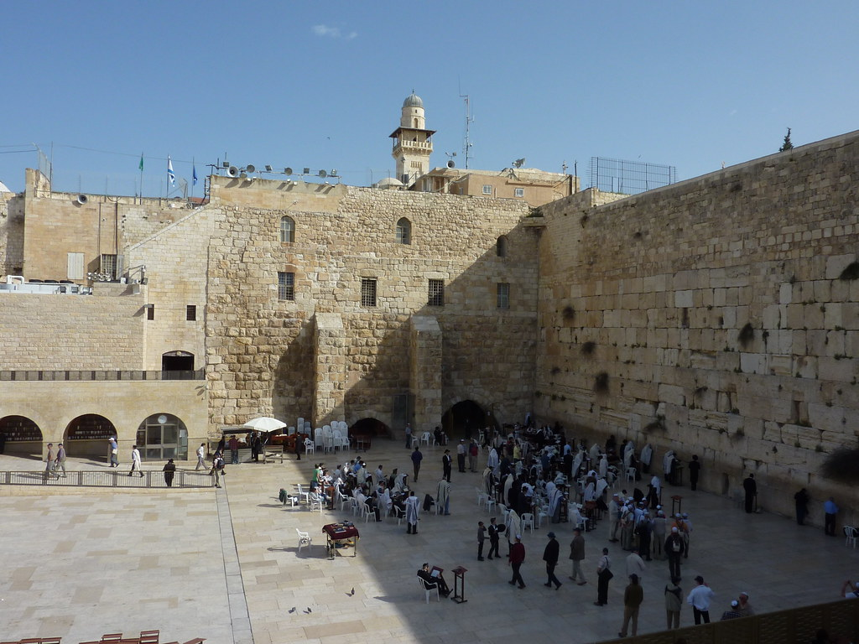
Gush Emunim –
The Bloc of the Faithful
Divine legitimation? Birthplaces of Hebrew religion under Israeli control. West Bank becomes Judaea and Samaria, again. Re-connection becomes obsession.
Gush Ideology?
Zionism proves World entered a Redemptive era.
Jewish people and Land of Israel are one. Sacred duty to stand firm.
God using all Jewish people – secular and religious.
Land given by divine grant – Palestinian opposition to dispossession is therefore immoral. The highest morality has waived their rights ( A Closed Ideological System)
Settlements need protection. Therefore, IDF deployed to protect, defensively.
Over time, their role, now explicit in orders, is to accompany settlers, to protect, and not restrain them - In anything they do.

Slide 8
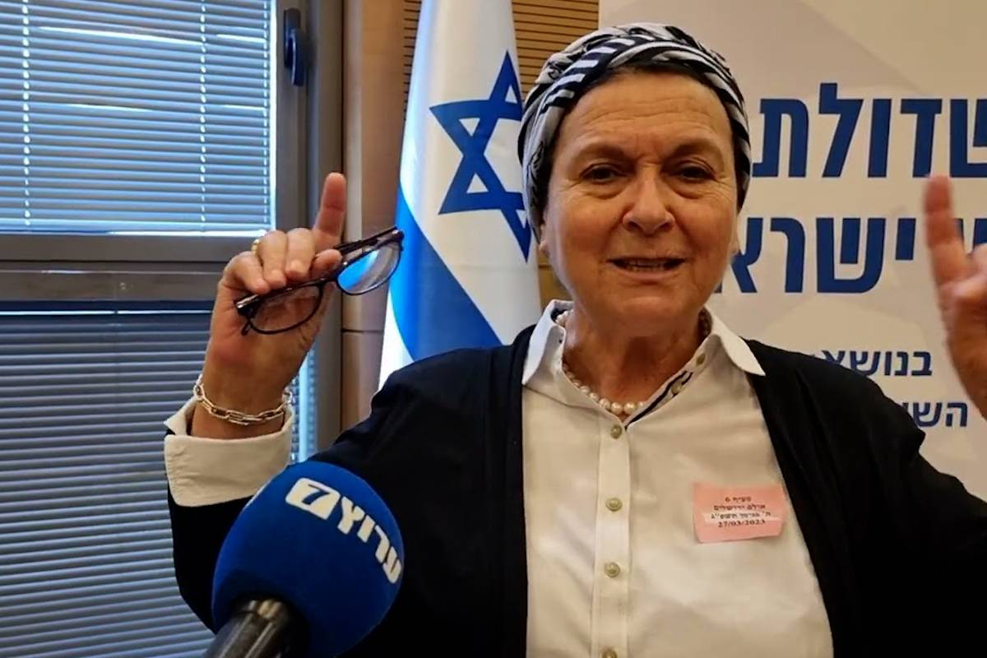
Nachala Settler Movement succeeds Gush
Focused on smaller, illegal settlements. But same goals. ie:
Annexation of all learned from Jordan River to the Mediterranean.
Resettle Gaza. Prevent a Palestinian state
‘Voluntary’ migration. Jewish supremacy/sovereignty.
Redemption through settlement – a prerequisite for the Messianic age.
Competing Messiah’s:
1: Christian: Jews to land, Armageddon, most die. (Antisemitic?)
2: Settler Messiah: Possess All the land first. Then Messiah will arrive
3: The Non-Zionist Jewish Messiah. Await his appearance, before return.

Slide 9
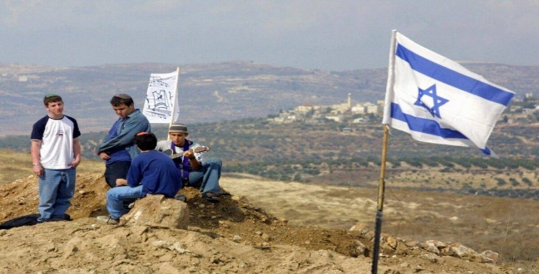
And there’s More
Kahanism (Rabbi Meir Kahane 1980’s)
Influenced Settlers and National Judaism – His Kach party, with a Far right, violent revenge is good, Jewish supremacist, anti Arab, racist, expulsionist, religious-nationalist ideology, pro Theocracy.
National Judiasm – Smotrich (Settler) Kippahs – Observant – God wills War
Ben-Gvir’s – Jewish Power - the ideological successor to Kahane.
From the margins to mainstream. Goals that were once unspoken are now vocalized. National Judaism and Neo-Kahanism are part of the government coalition. Their entry encouraged by Netanyahu.
Do you recognize a trend? Margins/Mainstream. Gaza War called a ‘Kahanist War.’
Never mind the current vanguard of Israel’s ‘Lost Boys,’ formerly ‘At Risk’ Hilltop Youth. Currently ‘Unofficially’ deployed in the West Bank, harassing, burning, destroying, killing,

Slide 10
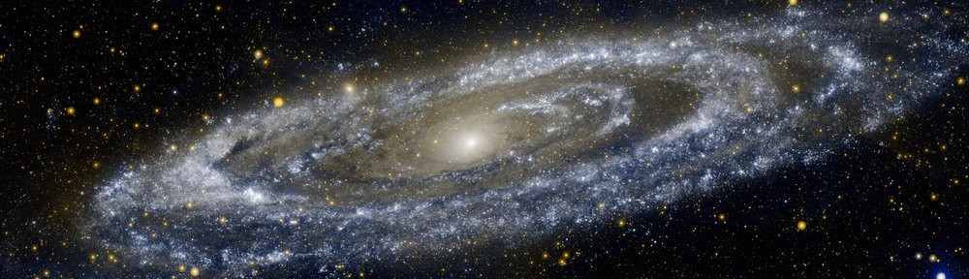
Forcing Gods Hand? Messiah Syndrome?
So, If we do this – He’ll do that …
Does the notion that we can twist the arm of a divinity by moving pieces on a chessboard, which will garner the required response, seem rather idolatrous?
That It’s all about us, and the right us, and not them…. Doesn’t seem Jesusy …

Slide 11

Jerusalem
Syndrome
.
Is a rare, acute psychiatric phenomenon where tourists or pilgrims, often without prior mental health issues, experience sudden, intense religious delusions upon visiting Jerusalem. It usually manifests as intense identification with biblical characters, such as believing oneself to be the Messiah, resulting in temporary, eccentric, or risky behaviors.
Please Try to Avoid. For it doth Make Men Mad

Slide 12
3: Here & There:
Northern Ireland & Israel/Palestine
Tragic Struggles:
National or
Intercommunal?
A Tragic Struggle is one of right against right But winners must make amends to the losers.
Comparisons and contrasts: Partitions – Citizenship Rights or Chosen People Narratives? - External actors
Competing Nationalisms. Two Traditions in Unionist Political Culture – Ulster Loyalist and Ulster British
Why Israel/Palestine is such a divisive issue here?
2 State Solution gone? Is Israel/Occupied Territories a De Facto Bi-National State but without equality?
In our sort of Bi-National State here, what have we learnt?

